Slide 1



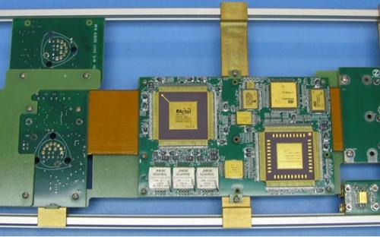
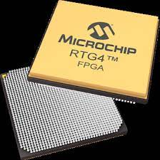
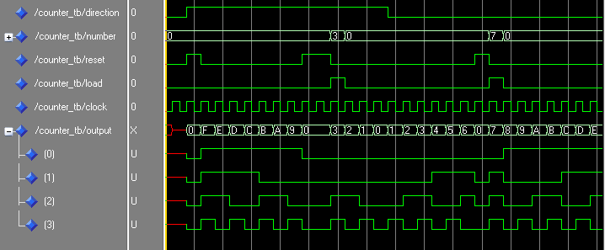


Complex Digital Logic and FPGA Capabilities
Complex Digital Logic and FPGA Capabilities
  ZIN has extensive digital logic design experience including proficiency in FPG implementation and ASIC development.
  ZIN has provided logic design, simulation, and implementation of FPGA designs, in VHDL and Verilog, including fault tolerant designs for Mission Critical applications.
  ZIN is compliant to the GSFC FPGA design and validation process and NASA-HDBK-4008.
Performance - For the NASA GSFC MMS mission ZIN provided a triple mode redundant digital
logic implementation with the following functions: 16-bit ADC interfaces, FIR filter for acceleration memory mapped registers, CPU reset for unrecoverable errors, software directed board-level reset, power rail enables and EEPROM controls. The
design was validated to the GSFC process including conducting a Worst Case Circuit Analysis (WCA). The WCA included end of life analysis.
TOOLS:
  FPGA Breadboard (Actel PROASIC 3E Development Kit)
  RTAX1000-CQ352M (Flight) & AX1000-FG896 (ETU)
  Tools: Actel’s Libero IDE (v9.0.3.7)
  Synthesis: Synplicity’s Synplify Pro (D-2009.12A)
  Simulation: Mentor Graphics’ ModelSIM ACTEL 6.5d (v2009.11)
  Place&Route: Actel Designer Software(v9.0.3.7)
  Static Timing: Actel’s SmartTime (v9.0 SP3A)
  Programming: BP Microsystems’ SculptW (v5.10.0 w/ Silicon Sculptor II)
  Electronics Control Loop Design
  MATLAB and Simulink
  ZIN has digital logic design experience including work in FPGA implementation and ASIC development. ZIN has provided logic design, simulation, and implementation of FPGA designs, in Very High Density Logic (VHDL) and Verilog, including fault tolerant designs with Finite Impulse Response (FIR) filters and interface controllers that used Triple Modular Redundancy (TMR) with error correction for non-hardened static random-access memory (SRAM) blocks. ZIN is compliant to the GSFC FPGA design and validation process.
  ZIN develops circuits, mixed signal boards, and single board computers for embedded systems. This involves the design, analysis, and fabrication of digital and mixed signal based solution for space-rated, radiation tolerant systems. ZIN has experience implementing Fault-Tolerant 32-bit LEON3 processor ASIC (UT-699) and the radiation hardened FPGA (RTAX-S) on a single custom rigid-flex Printed Wiring Assembly (PWA). Designed to IPC 6013 Class 3 standards.
ZIN Technologies Inc.
6745 Engle Road | Middleburg Heights, Oh 44130
Phone: 440.625-2223 | johansonm@zin-tech.com | www.ZIN-Tech.com

Slide 2


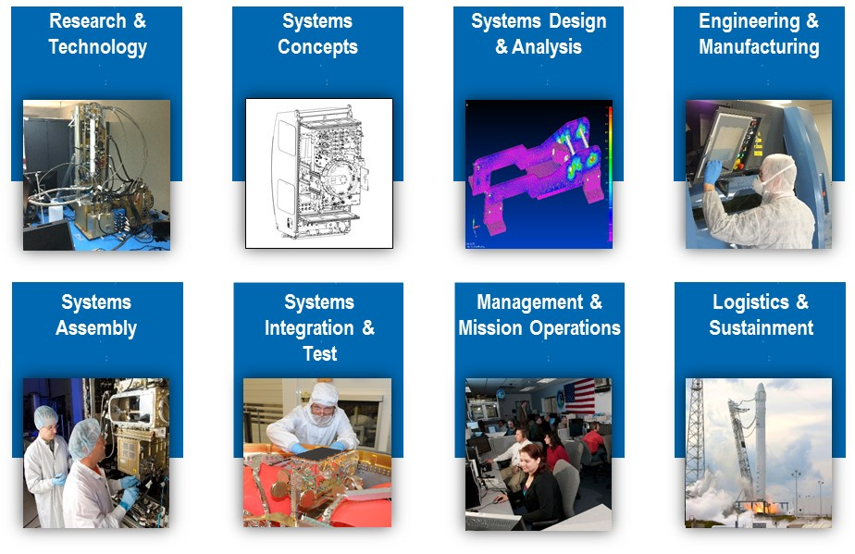
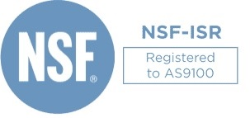

  Founded in 1957, ZIN provides multidisciplinary engineering services to NASA and the aerospace industry and has managed the development of space flight and ground system hardware (aerospace/space systems) from formulation, design, and development through to fabrication, integration, testing, verification, and mission operations.
  Our experience includes the development and validation of new technologies (sensors, inertial navigational measurement units (IMUs), composites, advanced acoustic resonant attenuation, optics, power, additive manufacturing and wireless/RF), ISS research investigations, space launch systems (Orion, commercial crew/resupply), satellite (IMU) accelerometer systems, and space based human research projects enabling future space and science missions.
  ZIN Technologies, Inc. is an experienced developer of ground and flight systems for manned and unmanned aerospace applications. Marking history for almost five decades, we have provided integrated hardware and software development products and services to NASA, DoD and Fortune 500 companies.
OUR PRODUCTS & SERVICES
  Minority Owned-SDB
  AS9100 certified
  Experienced Team of scientists, engineers, designers, and technicians
  DCAA Approved Forward Pricing
  Headquartered Cleveland Ohio
  Award Winning Capabilities
Focus on Quality - Certified and Compliant with Industry and Government Quality Standards
ZIN Technologies Inc.
6745 Engle Road | Middleburg Heights, Oh 44130
Phone: 440.625-2223 | johansonm@zin-tech.com | www.ZIN-Tech.com

